Slide 1
Types of AE
There are, basically, 7 types of autoencoders:
Stack Autoencoder
Denoising Autoencoder
Sparse Autoencoder
Deep Autoencoder
Contractive Autoencoder
Undercomplete Autoencoder
Convolutional Autoencoder
Variational Autoencoder

Slide 2
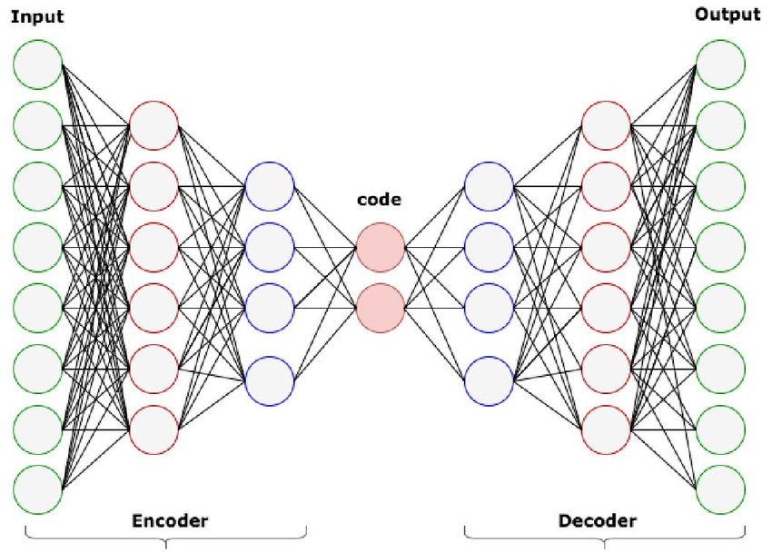
Stack Autoencoder

Slide 3
Denoising Autoencoder
Denoising autoencoders create a corrupted copy of the input by introducing some noise.
This helps to avoid the autoencoders to copy the input to the output without learning features about the data.
These autoencoders take a partially corrupted input while training to recover the original undistorted input.
The model learns a vector field for mapping the input data towards a lower dimensional manifold which describes the natural data to cancel out the added noise.

Slide 4
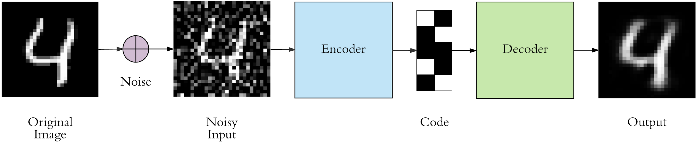
Types of AE - Denoising Autoencoder

Slide 5
Sparse Autoencoder
Sparse autoencoders have hidden nodes greater than input nodes.
They can still discover important features from the data.
A generic sparse autoencoder is visualized where the obscurity of a node corresponds with the level of activation. Sparsity constraint is introduced on the hidden layer.
This is to prevent output layer copy input data.
Sparsity may be obtained by additional terms in the loss function during the training process, either by comparing the probability distribution of the hidden unit activations with some low desired value,or by manually zeroing all but the strongest hidden unit activations.

Slide 6
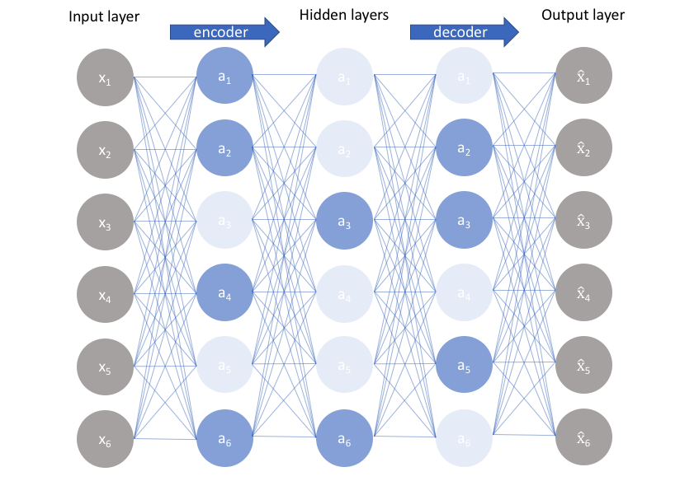
Types of AE - Sparse Autoencoder

Slide 7
Deep Autoencoder
Deep Autoencoders consist of two identical deep belief networks, One network for encoding and another for decoding.
Typically deep autoencoders have 4 to 5 layers for encoding and the next 4 to 5 layers for decoding.
We use unsupervised layer by layer pre-training for this model.
The layers are Restricted Boltzmann Machines which are the building blocks of deep-belief networks.
Processing the benchmark dataset MNIST, a deep autoencoder would use binary transformations after each RBM.
Deep autoencoders are useful in topic modeling, or statistically modeling abstract topics that are distributed across a collection of documents. They are also capable of compressing images into 30 number vectors.

Slide 8
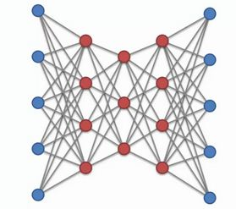
Deep Autoencoder

Slide 9
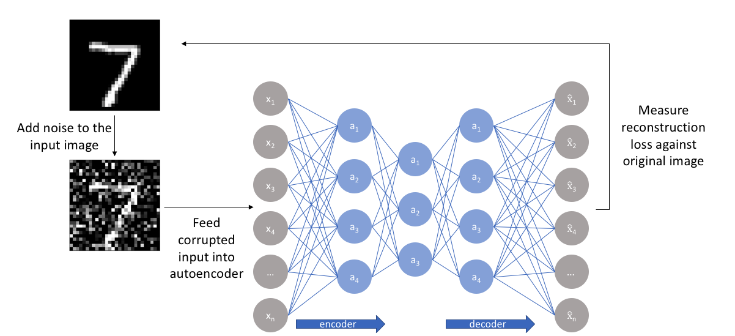
Contractive Autoencoder
The objective of a contractive autoencoder is to have a robust learned representation which is less sensitive to small variation in the data.
Robustness of the representation for the data is done by applying a penalty term to the loss function.
Contractive autoencoder is another regularization technique just like sparse and denoising autoencoders.
However, this regularizer corresponds to the Frobenius norm of the Jacobian matrix of the encoder activations with respect to the input.
Frobenius norm of the Jacobian matrix for the hidden layer is calculated with respect to input and it is basically the sum of square of all elements.

Slide 10
Undercomplete Autoencoder
The objective of undercomplete autoencoder is to capture the most important features present in the data.
Undercomplete autoencoders have a smaller dimension for hidden layer compared to the input layer. This helps to obtain important features from the data.
It minimizes the loss function by penalizing the g(f(x)) for being different from the input x.

Slide 11
Convolutional Autoencoder
Autoencoders in their traditional formulation does not take into account the fact that a signal can be seen as a sum of other signals.
Convolutional Autoencoders use the convolution operator to exploit this observation.
They learn to encode the input in a set of simple signals and then try to reconstruct the input from them, modify the geometry or the reflectance of the image.
They are the state-of-art tools for unsupervised learning of convolutional filters.
Once these filters have been learned, they can be applied to any input in order to extract features.
These features, then, can be used to do any task that requires a compact representation of the input, like classification.

Slide 12
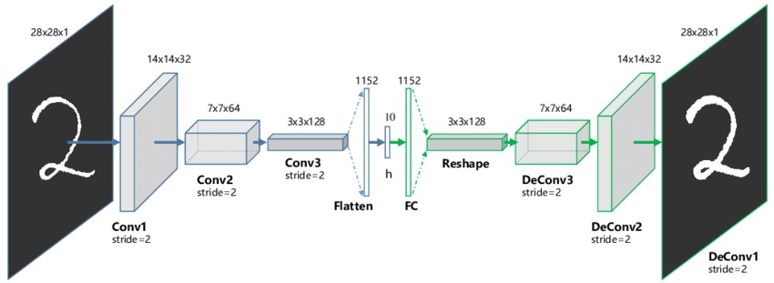
Types of AE - Convolutional Autoencoder

Slide 13
Variational Autoencoder
Variational autoencoder models make strong assumptions concerning the distribution of latent variables.
They use a variational approach for latent representation learning, which results in an additional loss component and a specific estimator for the training algorithm called the Stochastic Gradient Variational Bayes estimator.
It assumes that the data is generated by a directed graphical model and that the encoder is learning an approximation to the posterior distribution where Ф and θ denote the parameters of the encoder (recognition model) and decoder (generative model) respectively.
The probability distribution of the latent vector of a variational autoencoder typically matches that of the training data much closer than a standard autoencoder.

Slide 14
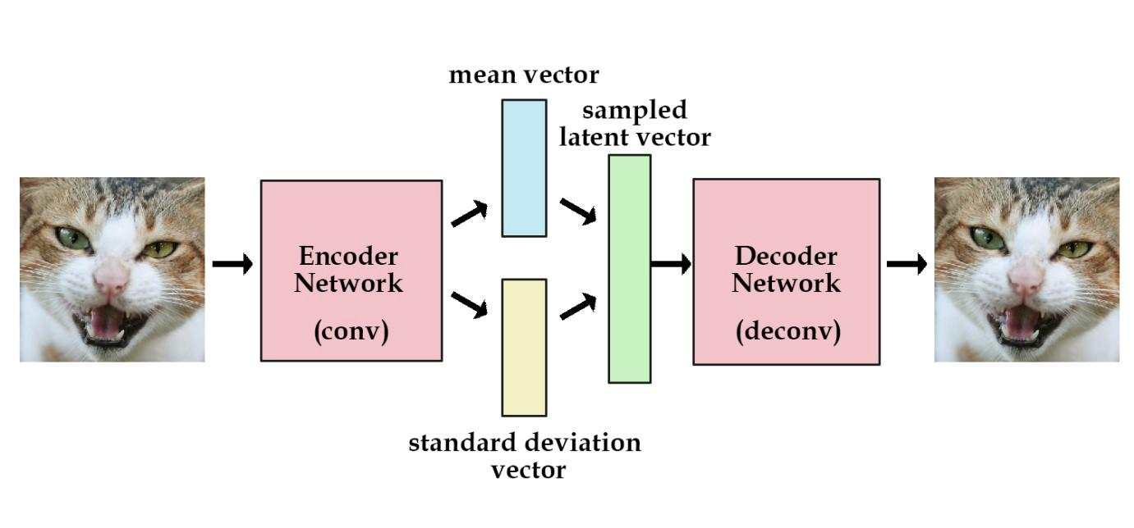
Types of AE - Variational Autoencoder

Slide 15
AE Applications
Dimensionality Reduction
Image Compression
Image Denoising
Feature Extraction
Image generation
Sequence to sequence prediction
Recommendation system

Slide 16
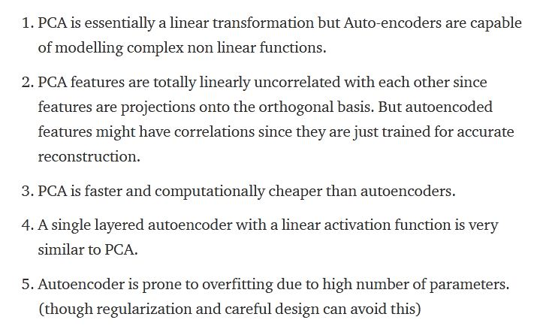
PCA VS Autoencoder

Slide 17
Thanks
https://en.wikipedia.org/wiki/Autoencoder
Likes, Share and Subscribe...

